Slide 1







CyberInbox
SU M ME R T RAI N I N G PR OJ E CT • I B M S KI L L SB U I L D AI
I N T E RN S H I P
Submitted by Avjeet Kumar
Technical Mentor Mr. Shubham Pathak
IBM
SkillsBuil
d

Slide 2




Problem Statement
TH E CH AL LE N GE
Electronic mail is a primary target for cybercriminals worldwide.
Organizations receive thousands of spam emails containing phishing links, malware, and scams.
Existing rule-based filtering mechanisms are ineffective against evolving spam techniques.
Objective: Develop an AI-based spam email detection system to distinguish spam from legitimate emails.

Slide 3



Abstract
OVE RVI E W
Spam emails distribute phishing links, malware, and ransomware — posing a constant risk to inboxes everywhere.
CyberInbox harnesses Natural Language Processing (NLP) and Machine Learning to tell spam from legitimate mail — automatically, and in real time.
Text Preprocessing
Lowercase · punctuation & stop-word removal · tokenization
Feature Extraction
TF-IDF Vectorization
A Logistic Regression classifier is trained on the SpamAssassin dataset, using TF-IDF vectorization for feature extraction.
Classification
Logistic Regression classifier

Slide 4
Objectives
GO AL S
01
Study different types of spam emails and their characteristics.
02
Preprocess rawemail data using NLP techniques.
03
Extract textual features using TF-IDF Vectorization.
04
Train a Machine Learning model for spam classification.
05
Develop a REST API using FastAPI for real-time predictions.
06
Build a responsive web application using React.js and Tailwind CSS.

Slide 5




Technologies Used
TE CH ST ACK
Python & FastAPI
React.js, Vite, Tailwind CSS
Scikit-learn, Pandas, NumPy
Backend REST API
Frontend Development
ML & Data Processing
NLTK, TF-IDF Vectorizer
Logistic Regression
REST API Layer
Natural Language Processing
Email Classification Model
Real-time prediction endpoint

Slide 6



Dataset & Preprocessing
DATA PI PE L I N E
Dataset: SpamAssassin Public Corpus — legitimate ('Ham') and spam-labelled emails.
01
02
03
04
Conversion to lowercase &
tokenization
Removal of HTML tags, URLs & email addresses
Removal of numbers, special characters & stop words
Whitespace normalization
Result: High-qualityfeatures with significantly reduced noise.

Slide 7
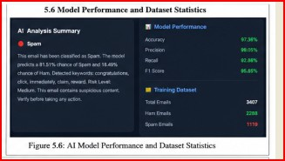
Feature Extraction & ML Model
M OD E LL I N G
TF-IDF Vectorization
Text Classification Pipeline
Term Frequency– Inverse Document Frequency
Converts rawtext into meaningful numerical vectors that a model can learn from
Logistic Regression Model
Selected for high accuracy, efficiency & low computational complexity
Learns the decision boundary separating Spam from Ham

Slide 8
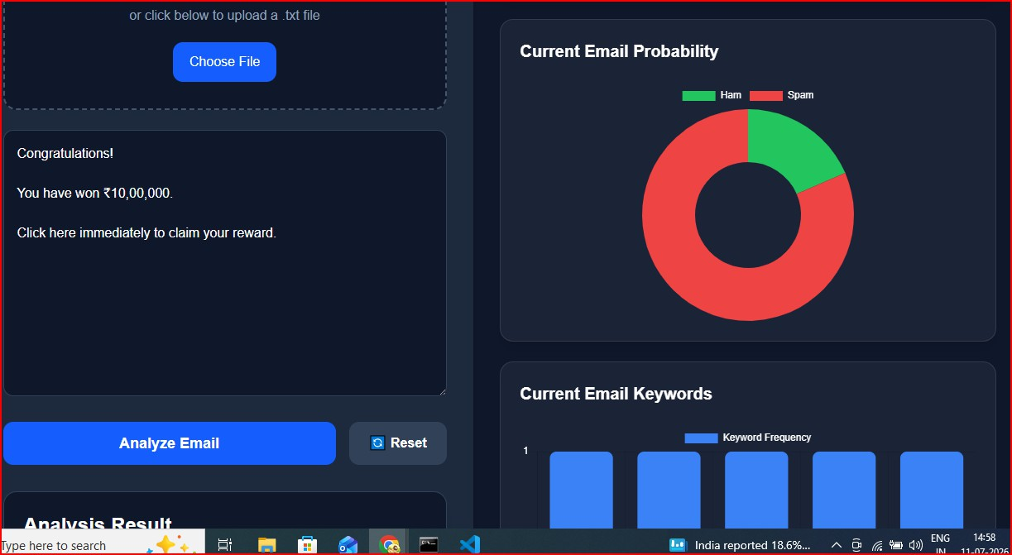
System Architecture
DE S I GN

Slide 9
Model Performance
RE S U LT S
The Logistic Regression classifier achieved excellent results on the held-out testing dataset:
97.36%
ACCURACY
99.05%
PRECISION
92.86%
RECALL
95.85%
F1 - SCORE
Successfully distinguishes spam emails from legitimate emails with high accuracy— validated across the full testing set.

Slide 10
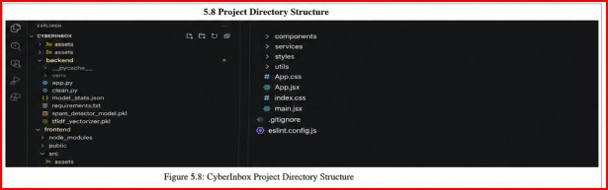
CyberInbox Interface
P ROD U CT

Slide 11
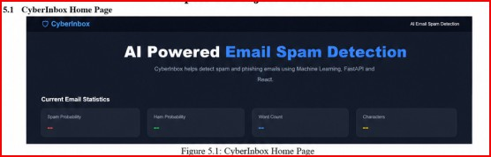
Real-time Email Analysis & Prediction
P ROD U CT

Slide 12


Conclusion & Future Scope
WRAP PI N G U P
Conclusion
Future Scope
Integration with Gmail and Outlook
Demonstrates successful application of AI/NLP for spam email classification
Integrates ML with FastAPI and React.js for an end-to-end real-time solution
Multi-language spamdetection and attachment analysis
Deployment as a browser extension or real-time enterprise email gateway

Slide 13


Thank You
CyberInbox — AI-Powered Email Spam Detection System
Avjeet Kumar • Mentor: Mr. Shubham Pathak • IBM SkillsBuild AI Internship

